Slide 1





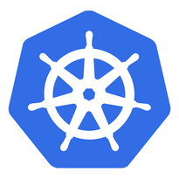

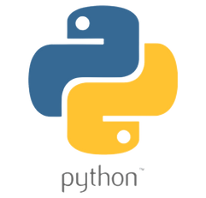






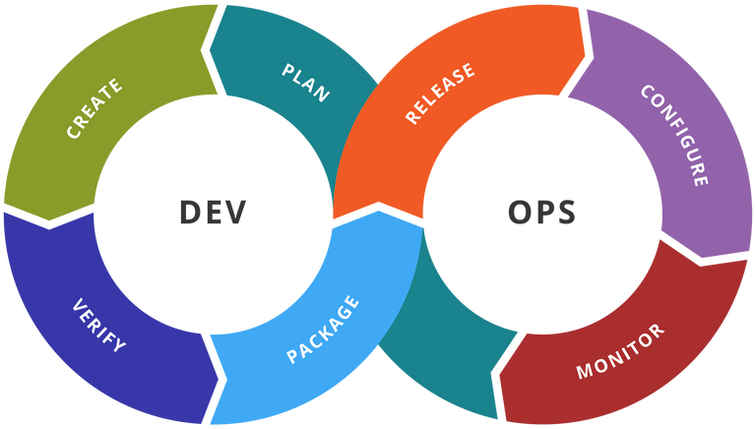

Community

Slide 2

About Us
Cloudnloud was started 11 years back with an intention of up-skilling and up-scaling all our members on the technical front with the niche topics around Cloud, DevOps,Data, AI and much More.
Cloudnloud was started by Vijayabalan Balakrishnan Who is a cancer survivor from Jan 2011. He is helping the Tech community and Cancer Children for the past 2 decades to loud from their own confidence in the IT industry. Officially it has become a registered Pvt Ltd on Jan-2015 to help and support cancer children from its revenue. Today Cloudnloud is living that dream with 6000 plus cancer children's survivors across the Globe.
WHO WE ARE
Community
02

Slide 3

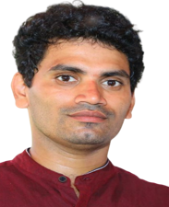
Sreekanth Kurapati
[AWS,Azure,Kubernetes,Docker,Ansible,Linux,Jenkins
Community

Slide 4
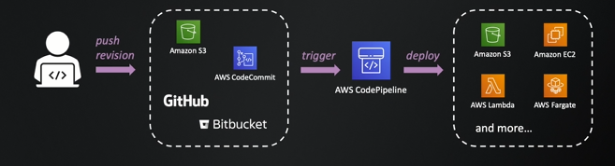
Community
AWS Code Pipe line
Community

Slide 5
1
Introduction to the Session
Today's
Agenda
2
Dev → Source S3 →codepipeline→Destination S3
3
Dev→code commit → code pipeline → S3 bucket
4
Dev →code commit →preprod →prod →destination
Community

Slide 6
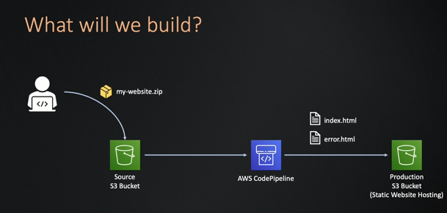
Source S3 →codepipeline→Destination S3
Community

Slide 7
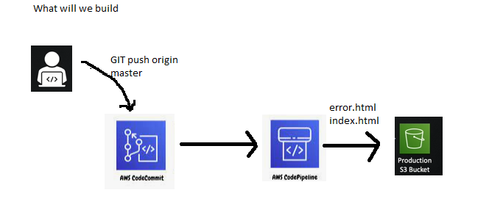
Dev→code commit → code pipeline → S3 bucket
Community

Slide 8
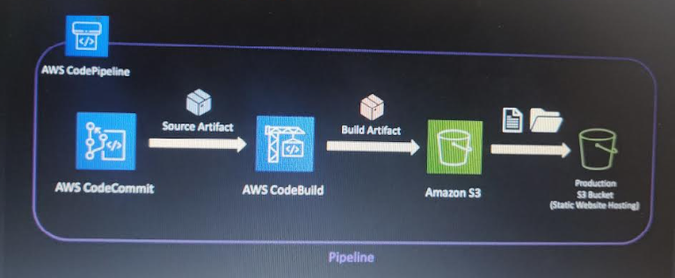
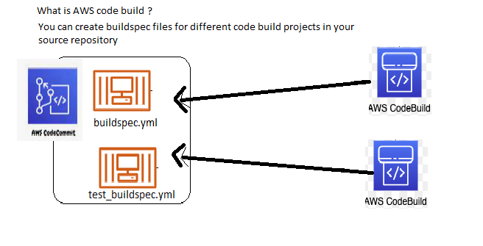
Dev →code commit →preprod →prod →destination
Community

Slide 9











Community
Connect Us to Loud better
cloudnloud
Join Discord Channel
cloudnloud.com
info@cloudnloud.com

